Slide 1
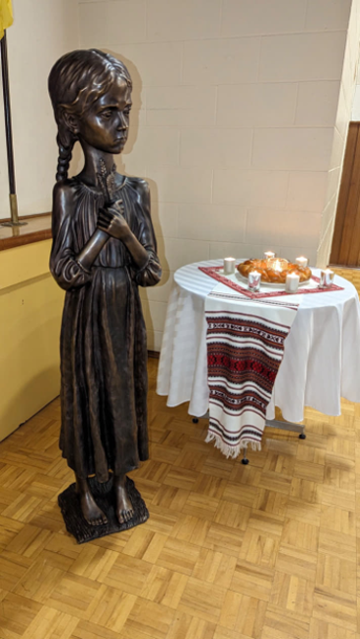
Holodomor Memorial Statue Donation
Purpose:
Seeking PAC advice and recommendations for the donation of the memorial statue, Bitter Memories of Childhood, a bronze statue of a girl holding 5 sticks of wheat and its installation on City Hall Campus.
Background:
On April 22, 2026 Council passed the motion “Holodomor Memorial Statue: Honoring Ukrainian-Canadians”, which provided in principle support for the acceptance of the donation and installation of the Holodomor memorial statue “Bitter Memories of Childhood”.
Staff were directed to facilitate the potential acceptance and installation on the Vancouver City Hall Campus, and report back to Council with recommendations to potentially accept and install the statue.
Staff are working with the applicant to assess their proposal in accordance with the City of Vancouver Commemoration Framework that guides decisions related to commemorations.
Title: Bitter Memories of Childhood
Artist: Petro Mykhailovych
Date: 2008
Medium: bronze
Size: approx. 5 ft tall
Donor/Applicant: League of Ukrainian Canadians

Slide 2
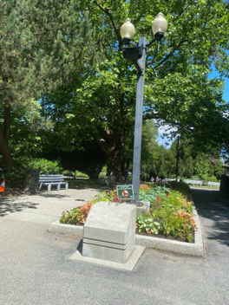
Holodomor Memorial Statue Donation
Proposed Location
About the Memorial Statue
The Holodomor was a man-made famine orchestrated by the Soviet regime that resulted in the deaths of millions of Ukrainians. The memorial statue serves to acknowledge the suffering of victims and survivors while promoting education, human rights, historical awareness, and opposition to totalitarianism.
Terms of Donation
Applicant will provide whole life funding for capital and operational costs for an intended 20 years lifespan.
Once all aspects finalized, an agreement will be drafted to establish the terms and conditions under which the City accepts ownership and agrees to display and maintain the approved commemoration.
Statue to be installed on existing concrete base, at the bottom of north stairs near City Hall Park

Slide 3
Holodomor Memorial Statue Donation
Assessment
The staff review of the application is guided by the Assessment Criteria and process outlined in the recently approved Commemoration Framework. These include: the extent to which the proposed commemoration holds broad community interest and support; is locally relevant; advances UNDRIP and equity; is feasible and whether there has been a two year pause since the event being commemorated.
Staff are seeking support from the Local Nations - xʷməθkʷəy̓əm (Musqueam Indian Band), Sḵwx̱wú7mesh Úxwumixw (Squamish Nation), and səlilwətaɬ (Tsleil-Waututh Nation) and confirmation that the proposed site is not of cultural significance to the Nations.
Staff seek advice and recommendations on the donation from Public Art Committee
Next steps
Once assessment is complete, a report will be brought forward to Council for decision.

